Slide 1
PACEMAKER SOUND
DR RAKESH JAIN
Senior resident, cardiology
Govt. Medical college, Calicut

Slide 2
PACEMAKER SOUND or click
It is a iatrogenic, high frequency, clicking sound sometime louder than S1
Can be heard but more often recordable
Produced by transvenous / epicardial pacemakers
Always a presystolic sound precedes the first heart sound by 0.08-0.12 second
Occurs after 6 msec of pacing stimulus for the duration of 80 msec.
Best heard in Mitral or tricuspid areas
Usually heard during expiration or decrease in intensity or absent during inspiration
May be associated with twitching of thoracic musculature in the region of the fifth intercostal space in the mid-clavicular line.
ALAN HARRIS et al. Brit. Heart J., 1967, 29, 608.
Joseph Schluger et al. CHEST, VOL. 61, NO. 7, JUNE 1972.

Slide 3
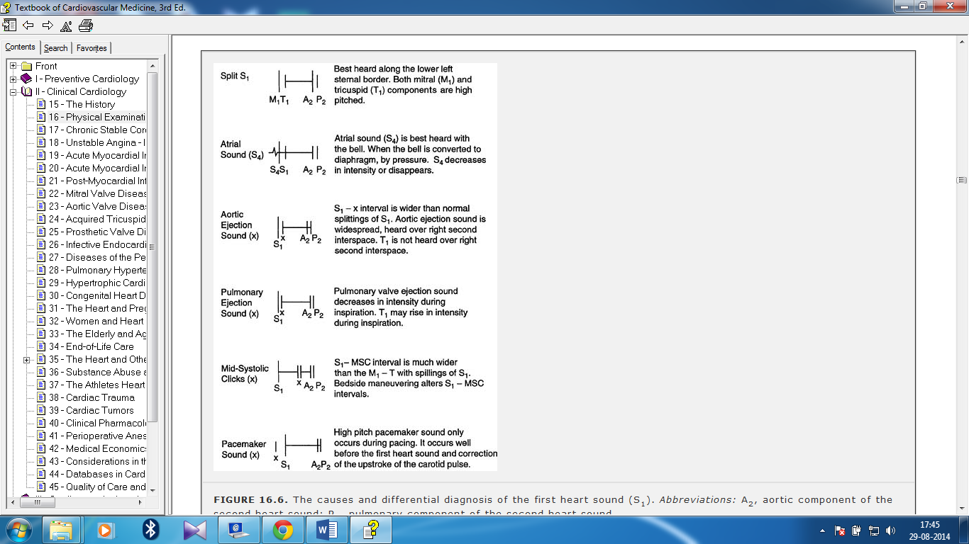
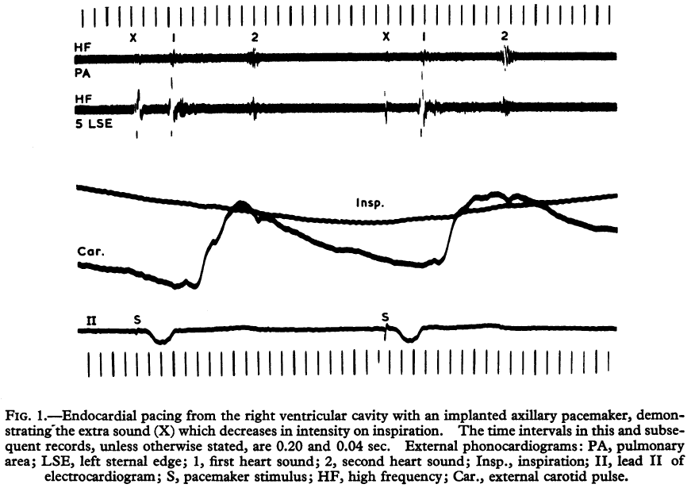
ALAN HARRIS et al. Brit. Heart J., 1967, 29, 608.

Slide 4
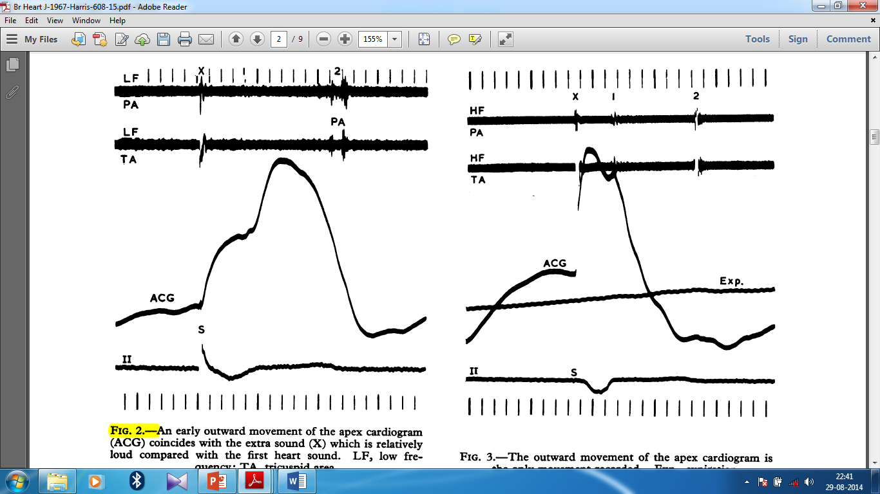
Apex cardiogram usually shows an early systolic outward movement, the onset of which coincides with the extra sound.
ALAN HARRIS et al. Brit. Heart J., 1967, 29, 608.

Slide 5
cause of pacemaker sound ?
Cardiac ?
Non Cardiac/ Extra cardiac ?
Non Cardiac / Extra-cardiac

Slide 6
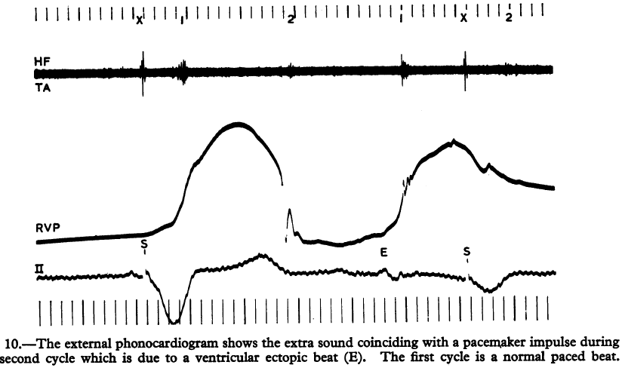
Why not cardiac ?
Pacemaker sound persist even when the pacemaker stimulus falls in the refractory period of the cardiac cycle therefore failed to stimulate the heart, strongly mitigates against a cardiac origin of the "click”.
ALAN HARRIS et al. Brit. Heart J., 1967, 29, 608.

Slide 7
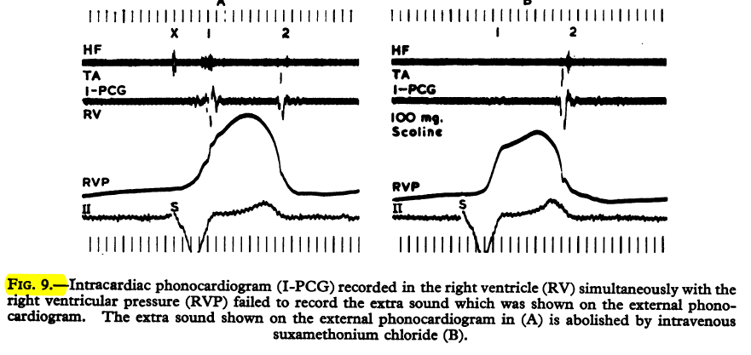
Intracardiac phonocardiogram (I-PCG) recording in the right ventricle (RV) simultaneously with the right ventricular pressure (RVP) failed to record the extra sound which was shown on the external phonocardiogram.
ALAN HARRIS et al. Brit. Heart J., 1967, 29, 608.

Slide 8
Why it is extra cardiac ?
Pacemaker sound get abolished by a neuromuscular blocking agent.

Slide 9
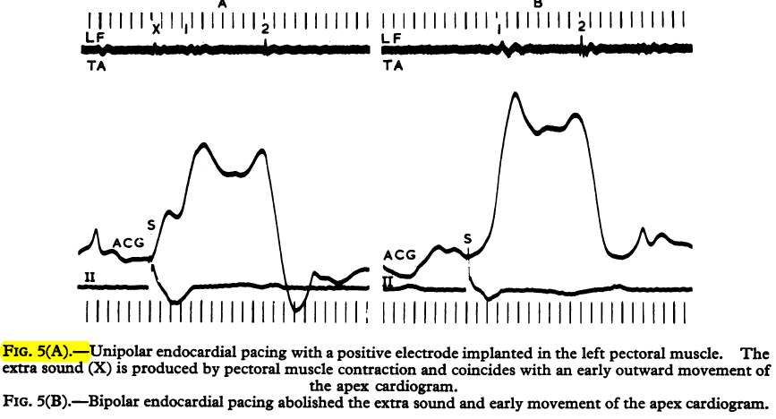
Extra sound simulating pacemaker sound and associated early apical movement can be reproduced by implanting the positive electrode of the pacing system in the left pectoral-muscle overlying the apex of the heart.

Slide 10
Interval between the pacemaker stimulus and the onset of the extra sound is 6 m.sec. which is of the same order as that of skeletal muscle electro-mechanical interval.
(Electromechanical interval for heart muscle is 21 millisecond)
ALAN HARRIS et al. Brit. Heart J., 1967, 29, 608.
Joseph Schluger et al. CHEST, VOL. 61, NO. 7, JUNE 1972.

Slide 11
Respiratory variations
Decrease in intensity or absent during inspiration
Lateral chest x-ray film showing the proximity of
endocardial electrode tip to the anterior chest wall.
Lateral chest x-ray film showing the proximity
of epicardial electrode to the anterior chest wall.

Slide 12
The failure to record any premature rise in ventricular pressure or intracardiac sound coinciding with the extra sound and the abolition of the extra sound by a neuromuscular blocking agent, forms conclusive evidence of an extracardiac source for this sound and of its origin from contraction of skeletal muscle.
?
Intercostal muscles v/s Diaphragm

Slide 13
Abnormal diaphragmatic contraction was not observed on x-ray screening and
Early systolic movement of the apex cardiogram is localized over the apex beat of the heart which can be reproduce by pectoral muscle stimulation.
Hence………
Concluded that the extra sound is due to stimulation of intercostal nerves adjacent to the epicardial or endocardial electrode because of electrical discharge from the tip of the electrode resulting in contraction of intercostal muscles.
ALAN HARRIS et al. Brit. Heart J., 1967, 29, 608.
Joseph Schluger et al. CHEST, VOL. 61, NO. 7, JUNE 1972.
Tsung 0. Cheng et al. CHEST, VOL. 62, NO. 1, JULY, 1972

Slide 14
Clinical Significance
May be mistaken for first heart sound or S4
May be the first sign of right ventricle perforation or abnormal position of pacing lead.
May indicate current leakage at the connection of the pacemaker generator and catheter leading to excessive current drain and premature battery exhaustion.
And at last ……..
If the electrode catheter is in its normal position, the patient with a pacemaker click should be observed carefully for premature battery failure.

Slide 15
Thanks

